Slide 1
Development Economics
ECON 4915
Lecture 4

Slide 2
Outline
Seminar 3
Discussion on group lending
Possible exam question
Insurance
    The problem of risk.
    Why doesn’t insurance markets work well?
    What can be done?

Slide 3
Seminar 3
Each group will present an article for 20 minutes.
E-mail me which article you choose.
The articles will be distributed on a first come, first served basis. (You are allowed to have the same article across groups but not within group).

Slide 4
Acemoglu, D., S. Johnson, and J. A. Robinson (2001).The colonial origins of comparative development: an empirical investigation, American Economic Review 91(5), 1369-1401.
Beaman, L. Chattopadhyay, R. Duflo, E., Pande, R, and Topolova P. (2009).Powerful Women: Does Exposure Reduce Bias?Quarterly Journal of Economics, 124 (4): 1497-1540.
Fujiwara, T. (2010), Voting technology, political responsiveness, and infant health: evidence from Brazil, University of British Columbia, mimeo.
Glaeser E, La Porta L., Lopez-de-silanes F., and Schleifer, A.Do institutions cause growth? Journal of Economic Growth, Vol. 9(3): 271-303.
Jensen, R. and Oster, E. (2009).The Power of TV: Cable Television and Women's Status in India*, The Quarterly Journal of Economics, 124 (3): 1057-1094.
Nunn, N. and Wantchekon, L. (2009), The slave trade and the origins of mistrust in Africa, NBER working paper.
Qian, N. (2008), Missing women and the price of tea in China: The effect of sex-specific earnings on sex imbalance, The Quarterly Journal of Economics, 123(3): 1251-1285.

Slide 5
Focus on the following
Research question
    What is the precise question to be answered?
    Is it interesting? Why should we care?
    Is it new? What is the contribution of the paper?

Slide 6
Focus on the following
Evidence
    Is a causal effect identified?
    Is the argument compelling?
    Are alternative explanations ruled out?
    Is the data appropriate?

Slide 7
Focus on the following
Conclusion
    Can the conclusion be generalized?
    What are the main problems, if any?
    What else would you like to know?

Slide 8
Group lending vs Individual lending
When should we expect higher risk taking?
How can we explain the results of the Mongolian experiment?
    Context? Time of evaluation? Or something deeper?
What happens to adverse selection in this study?

Slide 9
Typical exam question
3a) Banarjee and Duflo (2010) define microcredit as innovations that lower the administrative cost of making small loans. Describe these innovations and discuss their advantages and disadvantages (5 points).

Slide 10
Innovations
Dynamic incentives.
Group liability.
Repayment frequency and social interactions.
Simplified collection technology.

Slide 11
Typical exam question
3b) Evidence from behavioral economics suggests that people are not always rational. Discuss microcredit with reference to problems of temptation and self-control (2 points).

Slide 12
Insurance
The problem of risk.
Why doesn’t insurance markets work well?
What can be done?

Slide 13
Risk
Risk is a central fact of life for poor people.
Bad weather, for instance, can have disastrous consequences.
Another serious problem is that agricultural prices fluctuate a lot.

Slide 14
Consequences of high risk
Not only do the poor lead riskier lives than the less poor, but a bad break of the same magnitude is likely to hurt them more.
First, a cut in consumption is more painful for someone who consumes very little to start with.

Slide 15
Consequences of high risk
Second, when the relationship between income today and future income is S-shaped, the effect on the poor of a bad break may be much worse than temporary unhappiness.
Finally, the process is often reinforced by a psychological process.

Slide 16
Consequences of high risk
A common way of coping with risk is by being very conservative on the farm or in the business.
So, the risk borne by the poor is not only costly once a shock hits: The fear that something bad might happen has an independent effect on poor peoples ability to fully realize their potential, or capabilities.

Slide 17
To reduce risk, smoothing of consumption is necessary
How smooth consumption?
One way is via credit.
We have already seen that this is not very easy.
Another way is via self-insurance.

Slide 18
Self-insurance
Using one’s own wealth to smooth uncertain shocks in income.
The example of bullock markets (Rosenzweig and Wolpin 1993).

Slide 19
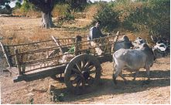
“A bullock cart in India”

Slide 20
Mutual insurance can also be used to smooth income
We have two farmers, A and B.
They produce the same crop and use the same amounts of land and other inputs.
The harvest yields 2000 NOK if all goes well and 1000 if it goes bad.
Probability of each event is 0.5.

Slide 21
Mutual insurance continued
If they decide on a mutual insurance scheme so that each farmer pays the other one 500 NOK in the case that one get a good harvest and the other one a bad harvest.
Then we get the following consumption stream with probability 0.25: 2000, 1000, 1500, 1500.

Slide 22
Mutual insurance continued
If the farmers are risk averse, this mutual insurance increases expected utility.
What happens if risks are perfectly positively correlated?
Perfectly negatively correlated?

Slide 23
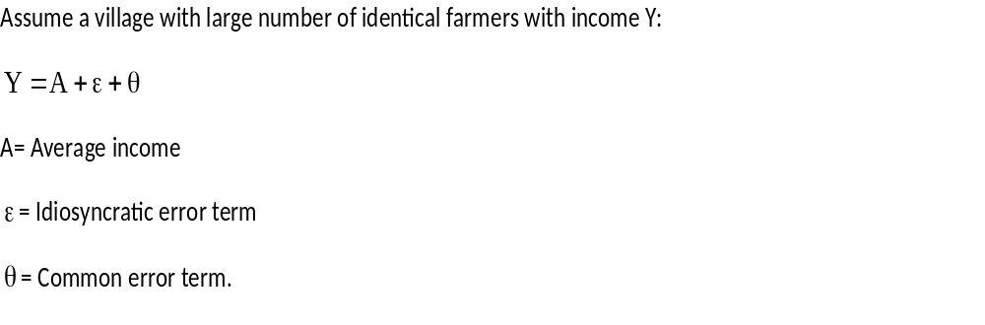
The perfect insurance model

Slide 24
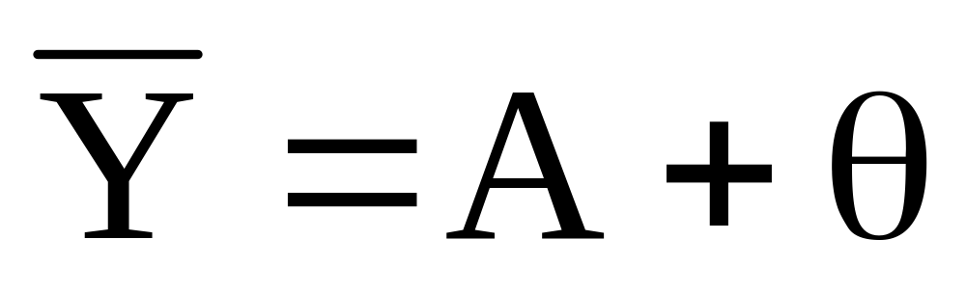
Insure away the idiosyncratic risk
So that all farmers recieve the same insured income:

Slide 25
How can the theory be tested?
If we have data over time from an entire village we can test whether they have perfect smoothing.
Set up the following model:
Where h=household, t=time, C= consumption, and y= income.

Slide 26
Findings
Townsend (1993) tested this in 3 villages in southern India.
Data on 40 households over time, every year from 1975 to 1984.
He could not reject that the coefficients on the group consumption was 1, and he also found that the coefficients on household income were close to zero.

Slide 27
But what do we actually learn about insurance?
There are at least 2 reasons to be skeptical:
SUGGESTIONS?
1)…
2)…

Slide 28
Why might we expect a problem with insurance?
Ray offers 3 basic reasons:
    Difficult to observe the final outcome
    Difficult to observe effort
    Difficult to enforce contracts

Slide 29
    Difficult to observe the final outcome
People may simply lie and if statements about outcomes are hard to verify, insurance may be impossible.
This has severe implications as it often limits the possible range of insurance in geography.
Institutions and social stratification are important factors.

Slide 30
Difficult to observe effort
Assume a large number of identical risk averse farmers.
All risk is idiosyncratic and output may be high (H) or low (L).
The probability of producing H is p if effort is high and q if it is low.
p>q.
Cost of providing high effort=C
u is the utility function.

Slide 31
The farmers net expected utility
Without insurance and high effort:
pu(H)+(1-p)u(L)-C
With low effort:
qu(H)+(1-q)u(L)
If we assume that each farmer in isolation find it worthwhile to provide high effort we get that:
pu(H)+(1-p)u(L)-C >qu(H)+(1-q)u(L)

Slide 32
Then risk aversion implies that there are gains from insurance
Risk aversion implies:
u(pH+(1-p)L) >pu(H)+(1-p)u(L)
If every farmer with high output pays (1-p)(H-L) into a common pool and every farmer with low output gets p(H-L), each farmer gets pH+(1-p)L for sure.

Slide 33
So, what’s the problem?
How are we going to ensure that each farmer put in the high level of effort under the insurance scheme?
If the level of effort is not observable to outside parties, this will not be possible. This is so since each farmer receives pH+(1-p)L for sure, i.e. regardless of the level of effort and high effort is costly.
So, there is a fundamental trade-off between the provision of insurance and the provision of effort. If the community wants to maintain effort at the high level, it will have to offer incomplete insurance not to distort incentives.

Slide 34
So, informational constraints pose a real problem to effective insurance.
Groups with better access to information of their members are therefore in a better position for providing mutual insurance.
Altruism…
…and social norms more generally.

Slide 35
Difficult to enforce contracts
Assume a large number of identical risk averse farmers in a setting effort levels are perfectly observable.
All risk is idiosyncratic and output may be high (H) or low (L) and the probability of producing H is p.
Under perfect insurance each farmer receives pH+(1-p)L as we saw before. Call this amount M.
Let N be number of periods.

Slide 36
Difficult to enforce contracts
In a given year with high output, the gain from ignoring the insurance scheme is u(H) – u(M).
The loss is N{u(M) – [pu(H)+(1-p)u(L)]}
Plus any social sanctions, S.
The enforcement constraint is thus that:
N{u(M) – [pu(H)+(1-p)u(L)]}+S > u(H)-u(M)

Slide 37
What does this tell us?
The larger S, the more social sanctions, the more likely is it that the enforcement constraint holds.
If people are likely to interact over a longer period, if N is higher, the more likely is it that the enforcement constraint holds.

Slide 38
The problem of adverse selection
Adverse selection: not knowing whether a client is of high or low risk.
Not well covered in Ray.
Example with health insurance: those who know that they are more likely to become sick in the future may be more likely to get an insurance.
Higher price may make it even worse as it drives away those who know they will probably not need the insurance.

Slide 39
So, as in credit markets…
The fundamental problems of insurance are moral hazard and adverse selection.

Slide 40
What can be done?
Insure the weather instead of the crop, maybe in a two tier system.
Rapid Conflict Prevention Support (RCPS)
Miguel and Fisman argue that this type of insurance can play a big role in foreign aid.
The state as a large risk pool.

Slide 41
Some questions at the research frontier
Behavioral development economics on the psychological costs of poverty and risk.
Why are some forms of risk less covered than other?
Micro-insurance.

